Slide 1
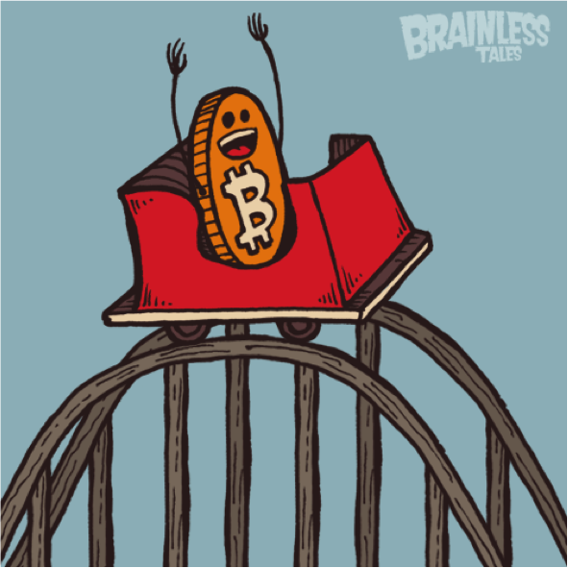
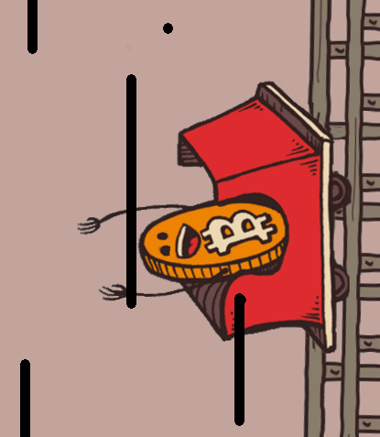
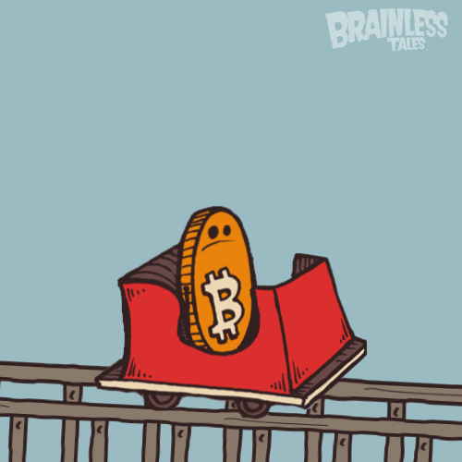
Intro to Bitcoin
Montreal
Alex Melville

Slide 2
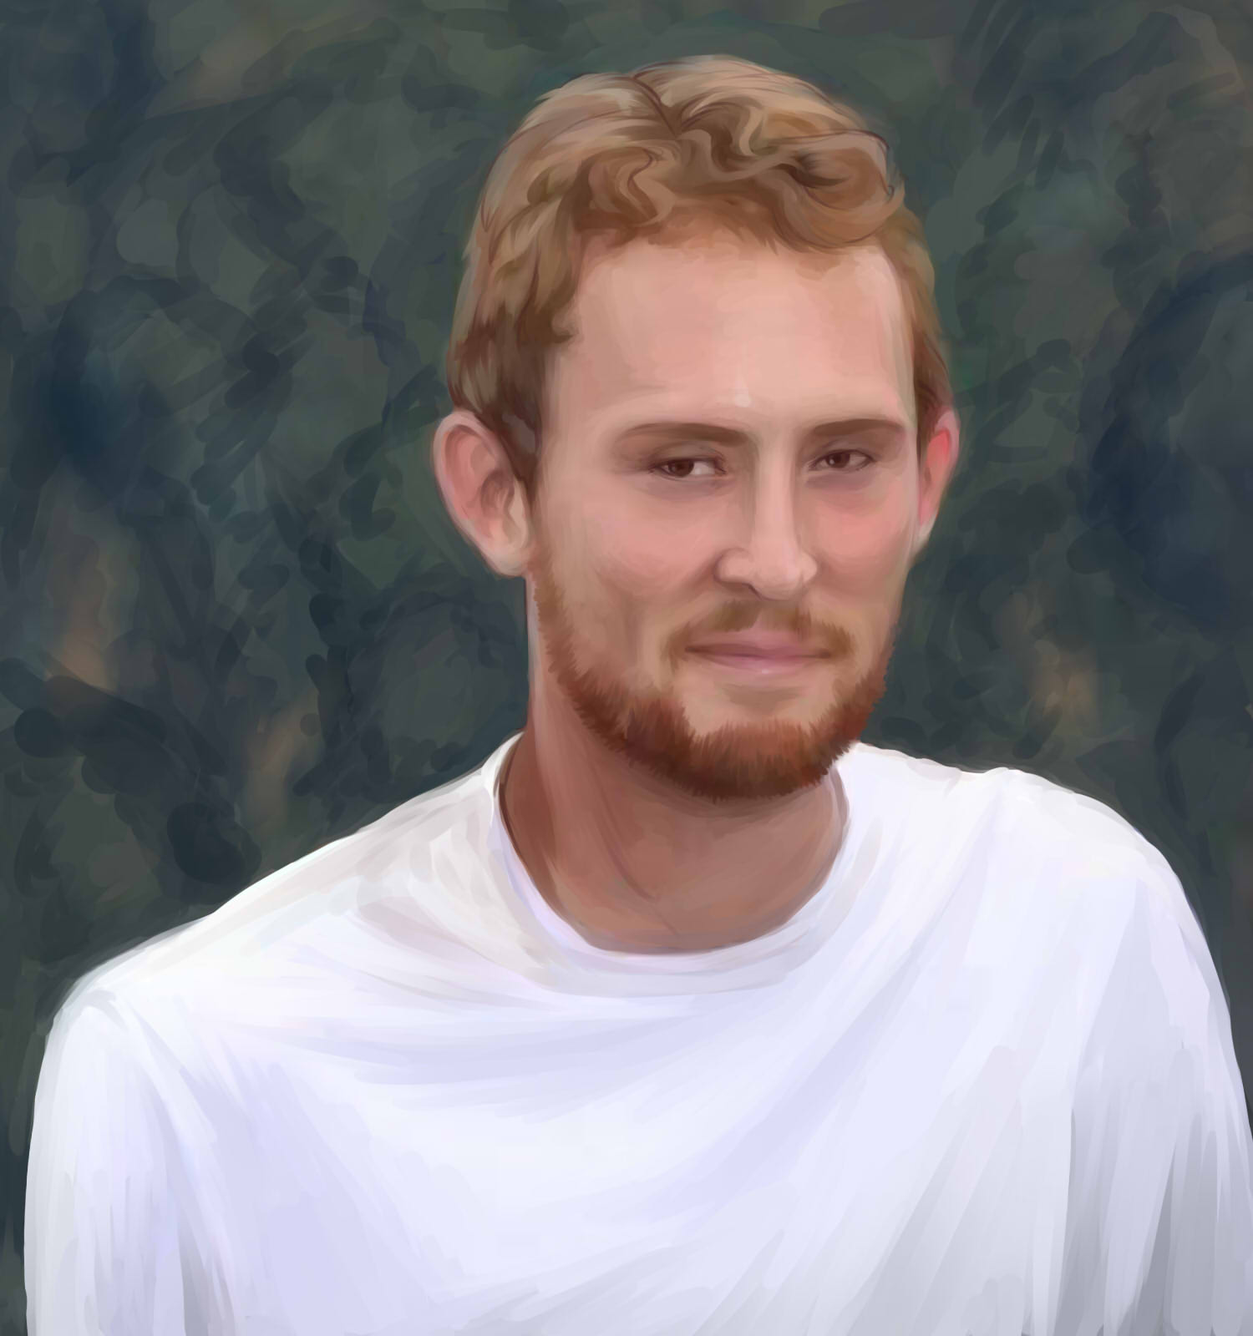

Alex Melville
Software Engineer @BitGo
World Traveler
github.com/Melvillian

Slide 3
Tonight
40 minute intro talk
5 minutes for questions
30 minute break
40 minute technical talk
5 minutes for questions
freedom!

Slide 4
Intro to Bitcoin
A Short History of Bitcoin
Real World Examples
What IS Bitcoin?
How Do I Value Bitcoin?
How It Works
Addresses, Blocks, Miners Developers
Done!

Slide 5
Why I’m Here Tonight
We’re just getting started
Most exciting time to be in the cryptocurrency space is right now
Solving problems nobody has ever solved before
I love what I’m doing, and I want to share it with you so perhaps you can dive in and go from knowing nothing (like I did) to waking up each day thinking about what can I work on today

Slide 6
a story, a story...

Slide 7
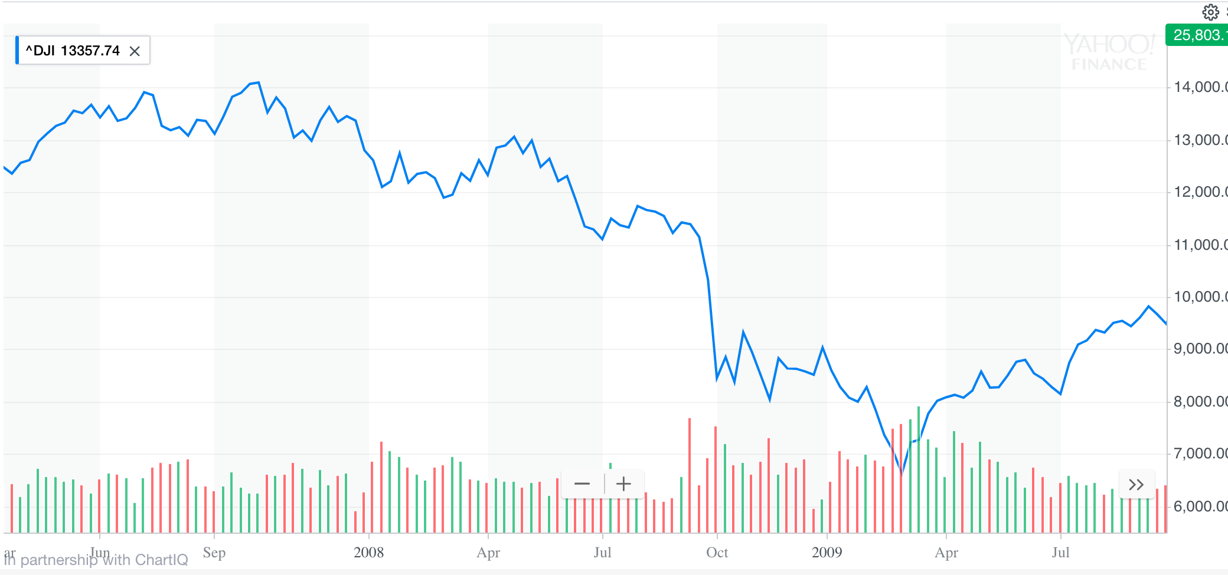
2008 (The Great Recession)

Slide 8
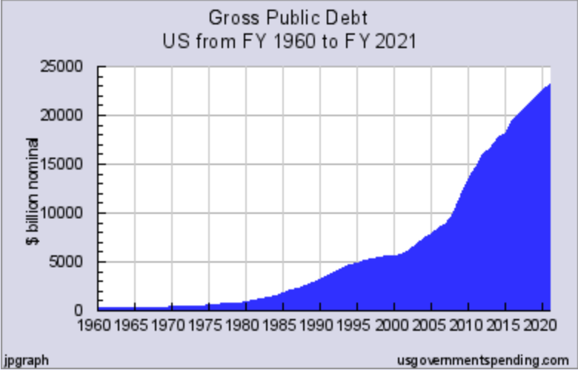
2008 (The Great Recession)

Slide 9
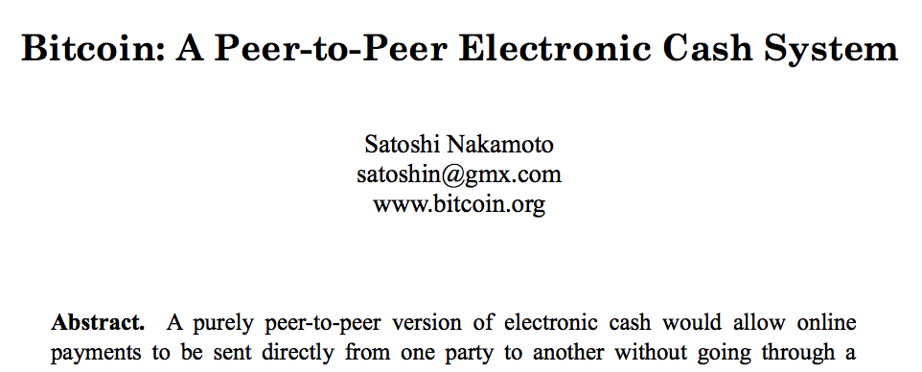
2009 (Birth of Bitcoin)

Slide 10
Before Bitcoin
Alice
Bob

Slide 11

Before Bitcoin
Alice
Bob

Slide 12
Before Bitcoin
Please send Bob $100
Alice
Bob

Slide 13
Before Bitcoin
Please send Bob $100
Bob, you now have $100
yay!
Alice
Bob

Slide 14
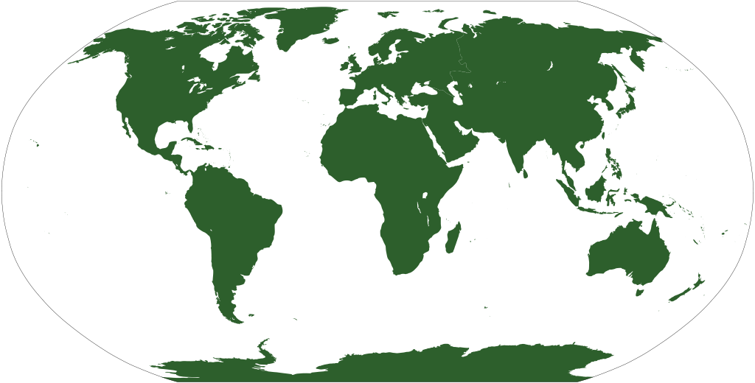
After Bitcoin
Hey!

Slide 15
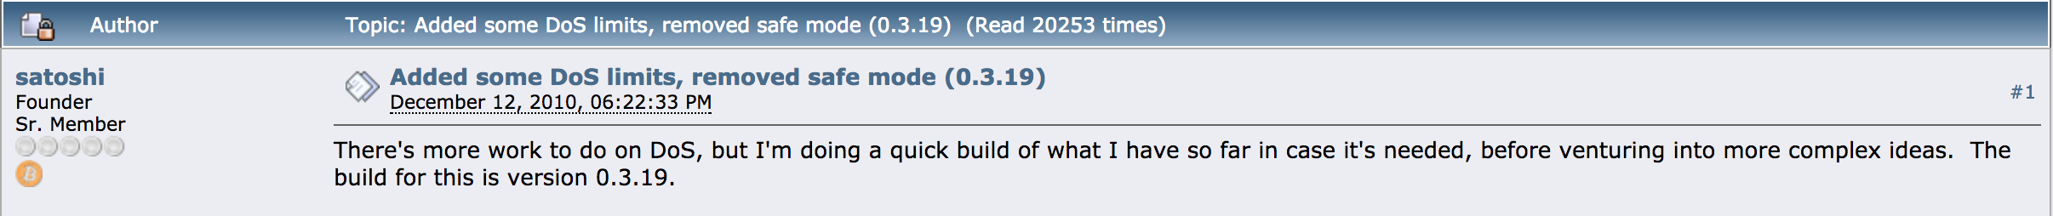
2010 (Last Post by Satoshi Nakamoto)

Slide 16
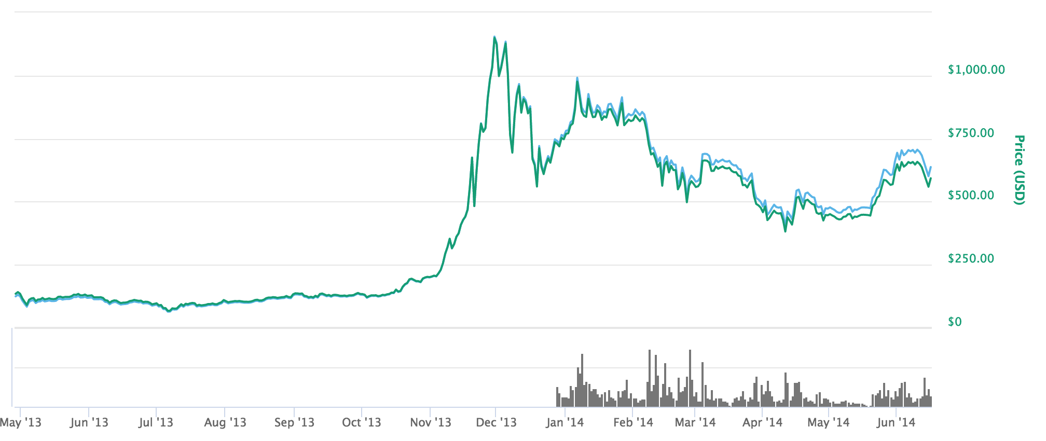
2010-2013 (Software Growth, Mt. Gox Crash)
Beginning of
Mt. Gox collapse

Slide 17
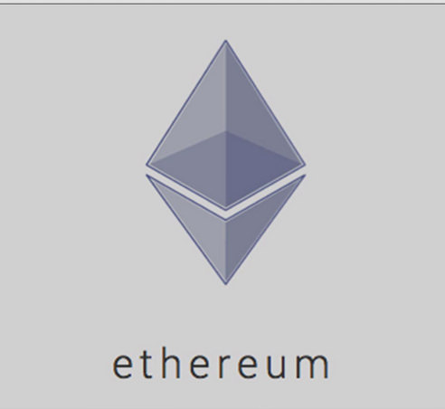
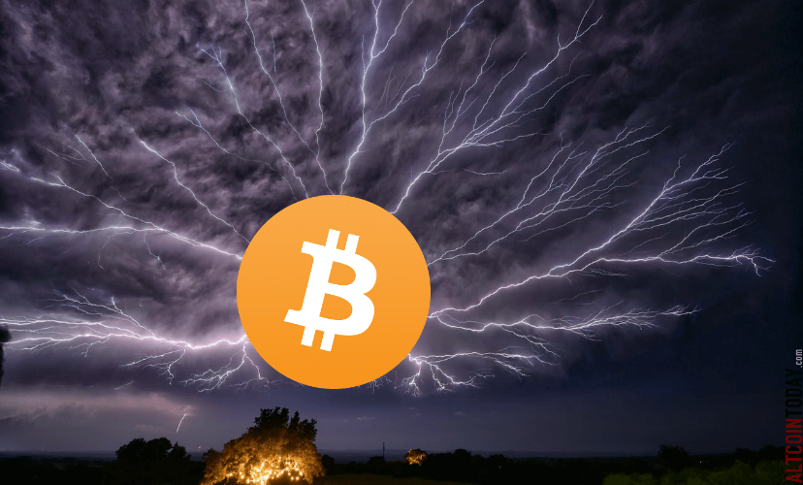
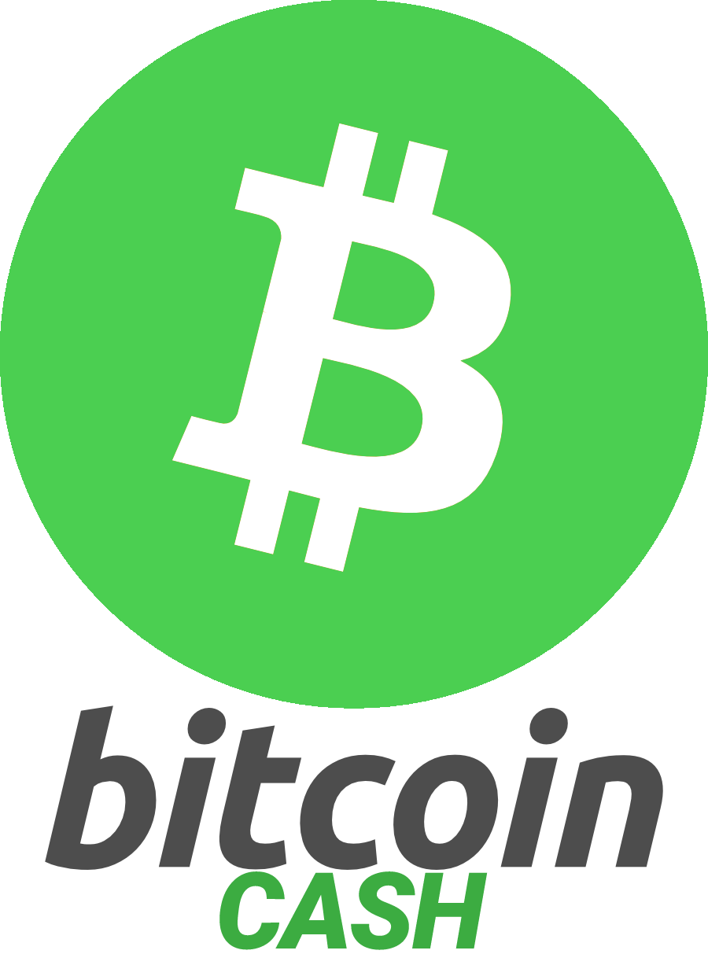

2013-Present (Too Many to Mention!)

Slide 18

Real World Examples (bread wallet)

Slide 19
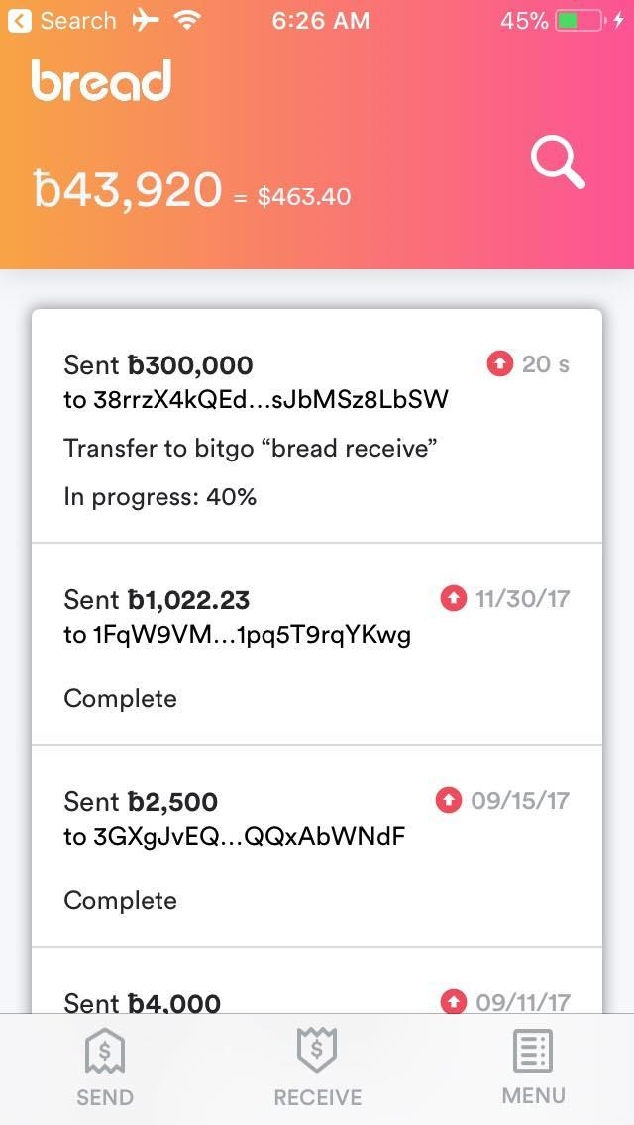

Slide 20
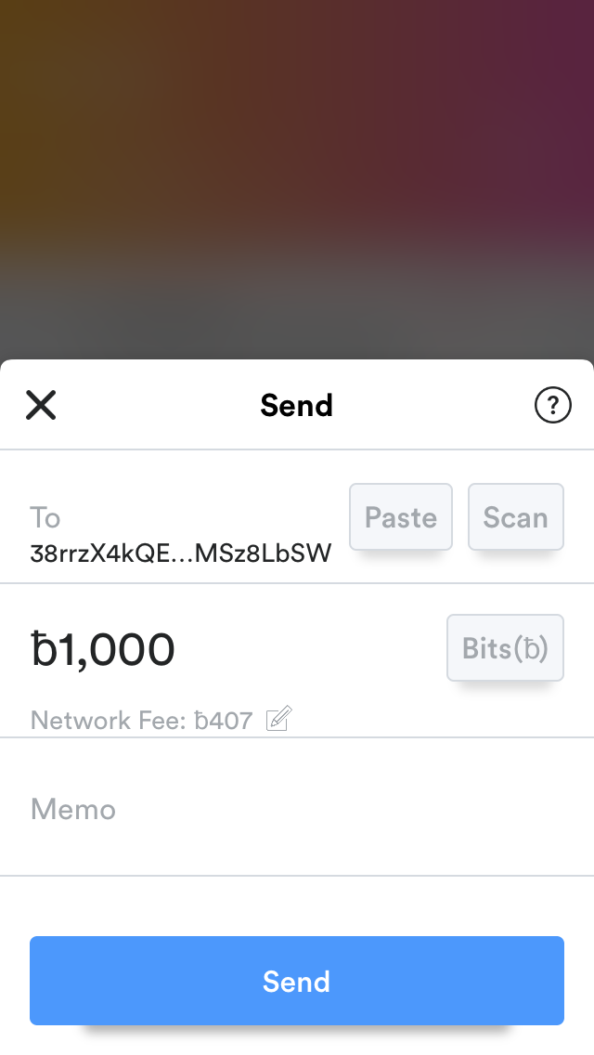

Slide 21
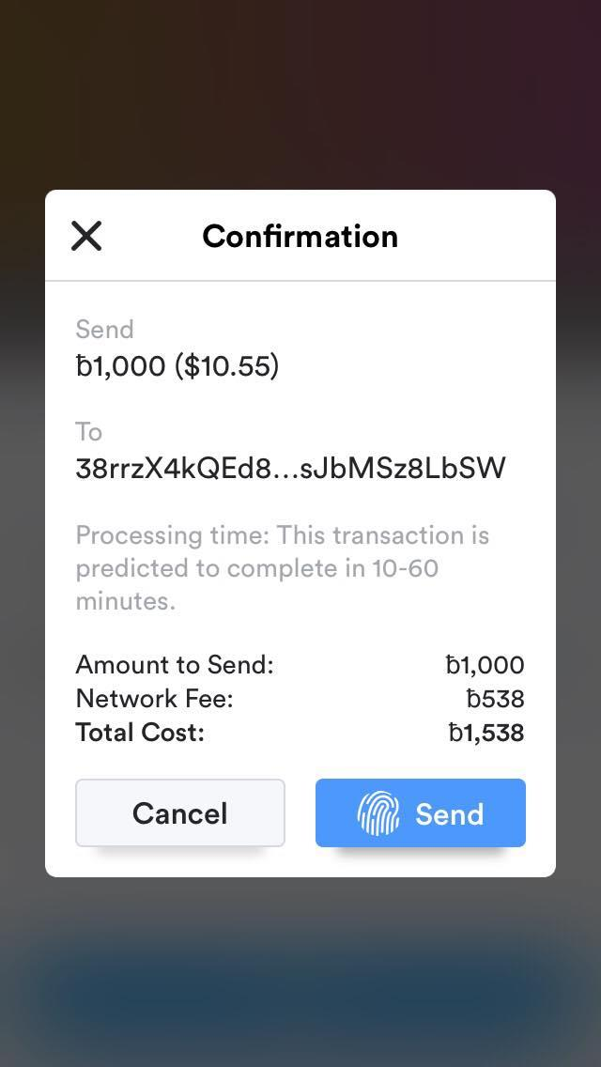

Slide 23
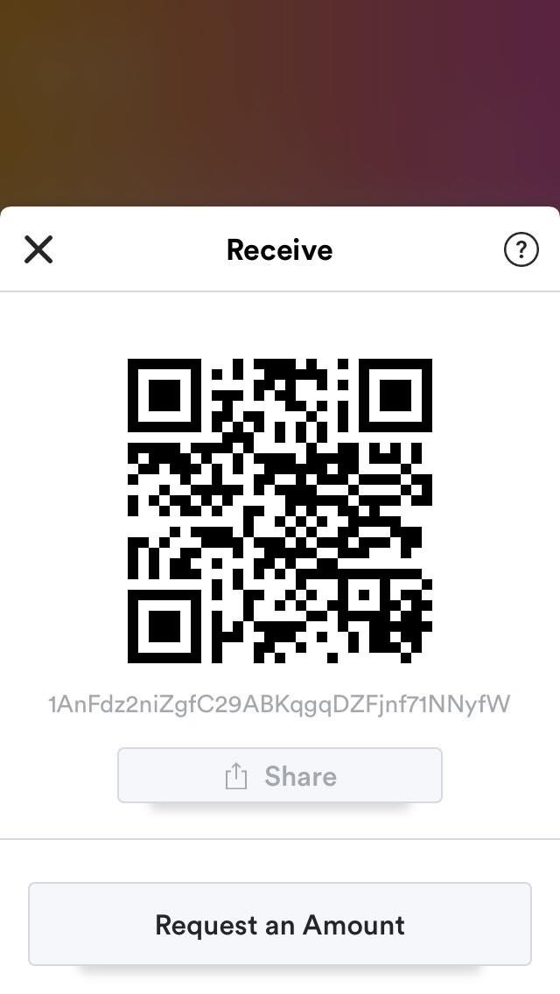

Slide 24
What IS Bitcoin?

Slide 25
What IS Bitcoin?
Bitcoin is about Trust

Slide 26
What IS Bitcoin?
Bitcoin is about Trust
Let’s you send money to anyone on the planet (with an Internet connection) without a third-party (bank)

Slide 27
What IS Bitcoin?
Ledger
Global
Decentralized
Append-Only
Cryptographic Security

Slide 28
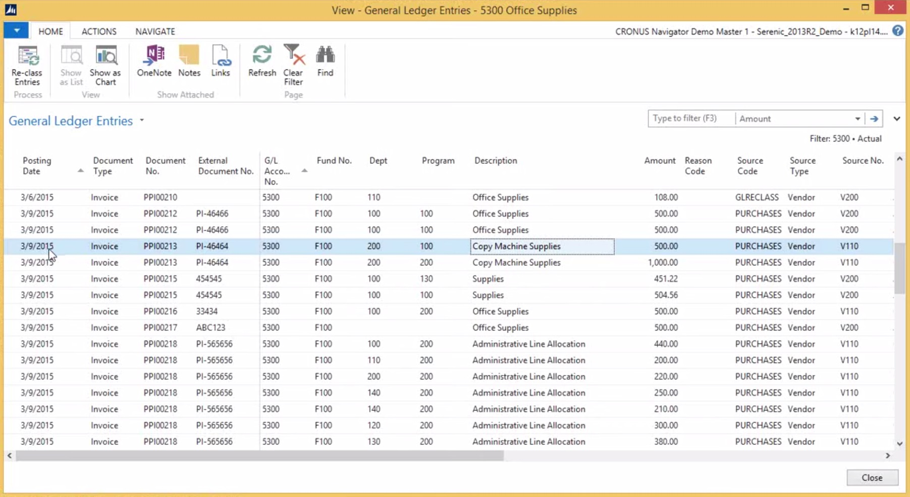
What IS Bitcoin?
Ledger

Slide 29
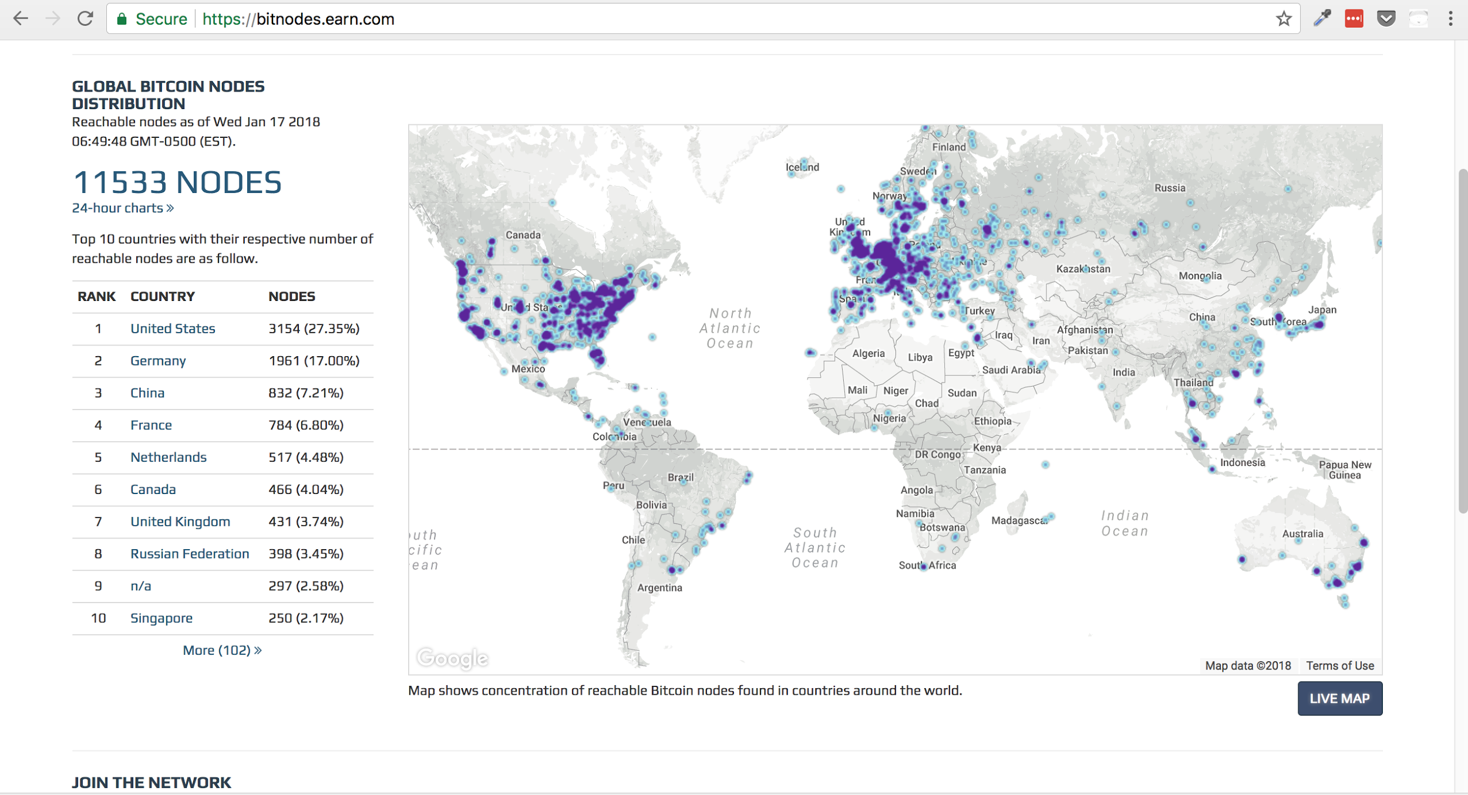
What IS Bitcoin?
Ledger
Global

Slide 30
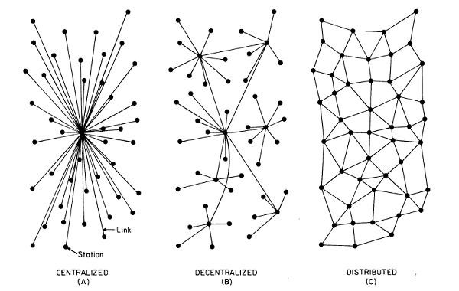
What IS Bitcoin?
Ledger
Global
Decentralized

Slide 31
What IS Bitcoin?
Ledger
Global
Decentralized
Append-Only
Block #1

Slide 32
What IS Bitcoin?
Ledger
Global
Decentralized
Append-Only
Block #2
Block #1

Slide 33
What IS Bitcoin?
Block #3
Ledger
Global
Decentralized
Append-Only
Block #2
Block #1

Slide 34
What IS Bitcoin?
Ledger
Global
Decentralized
Append-Only
Block #1

Slide 35
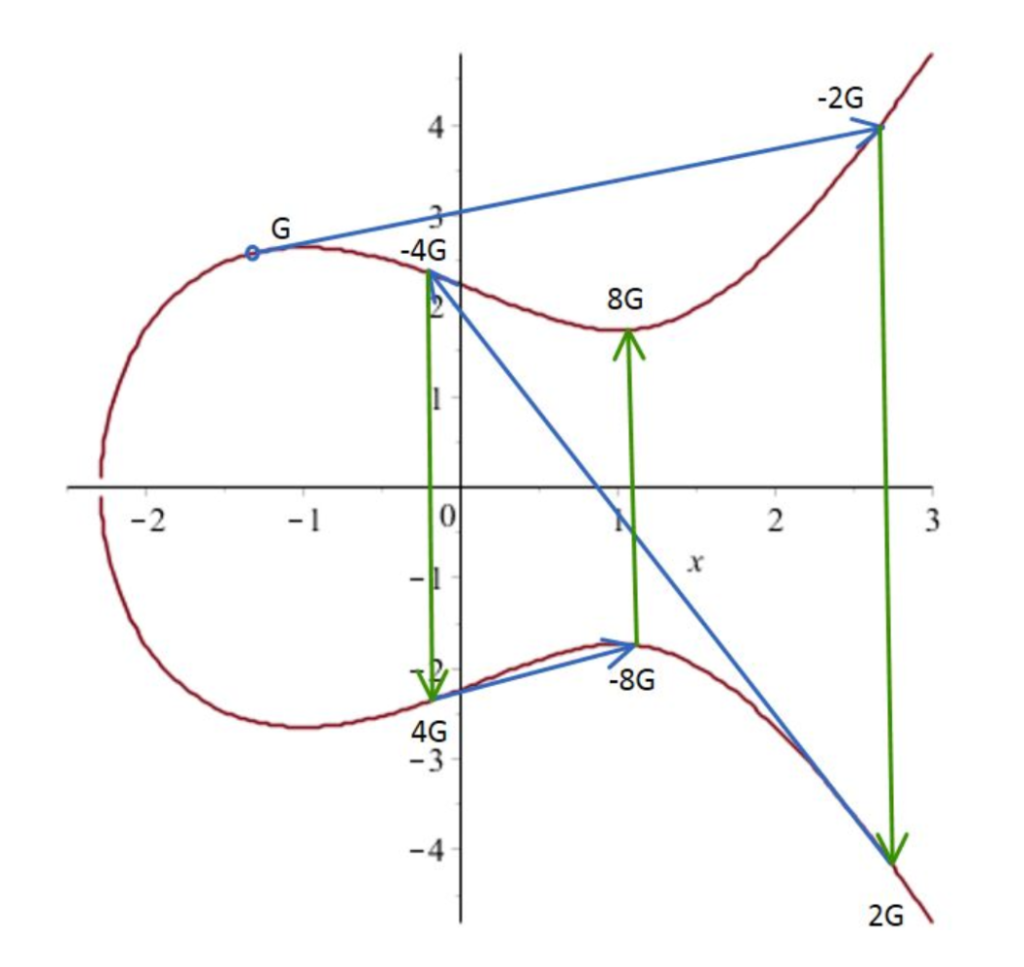
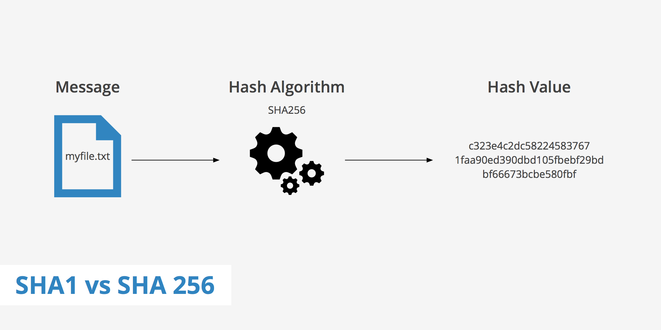
What IS Bitcoin?
Digital Signatures
Ledger
Global
Decentralized
Append-Only
Cryptographic Security
Cryptographic
Hash Functions

Slide 36
How Do I Value Bitcoin?

Slide 37
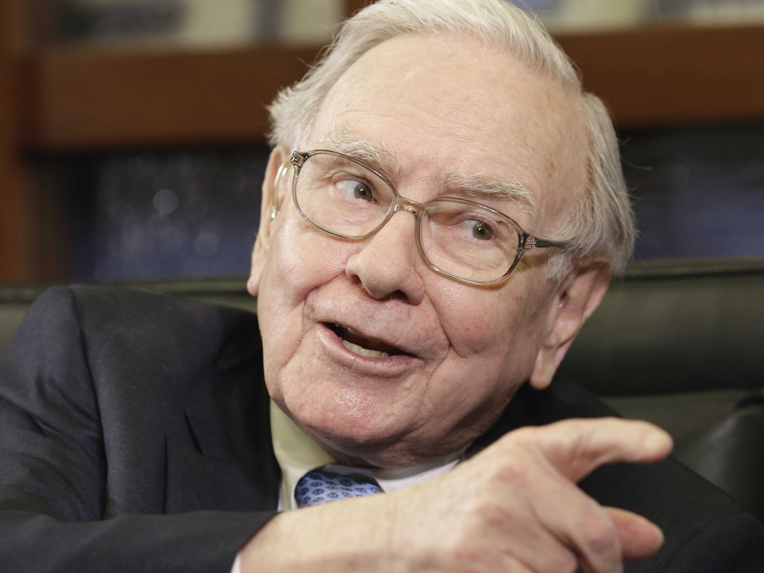
How Do I Value Bitcoin?
Tough Question

Slide 38
How Do I Value Bitcoin?
Tough Question
Attempt #1: Cost to secure the network (Miner cost)

Slide 39
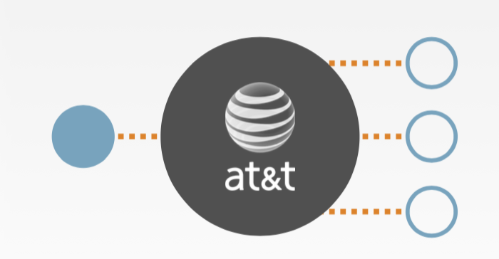
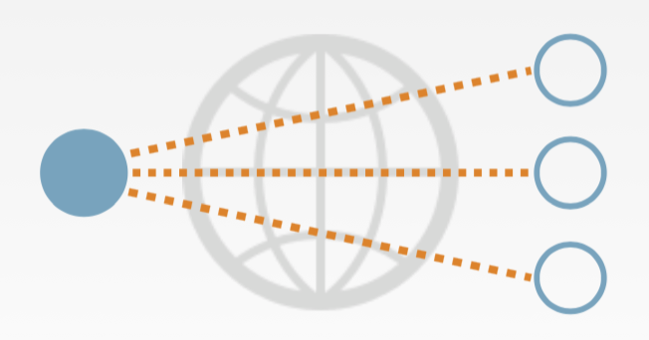
How Do I Value Bitcoin?
Tough Question
Attempt #1: Cost to secure the network (Miner cost)
Attempt #2: What’s the value in being able to programmatically transact with anyone who has an Internet connection?
Before Internet
After Internet

Slide 40
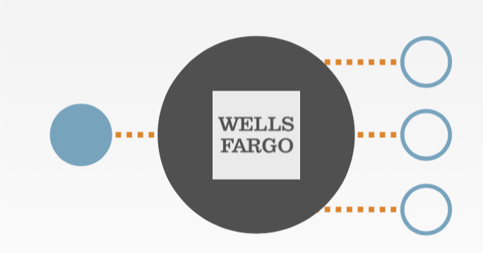
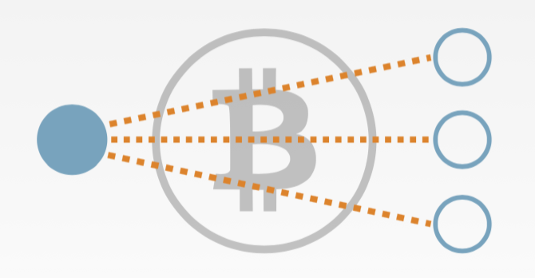
How Do I Value Bitcoin?
Tough Question
Attempt #1: Cost to secure the network (Miner cost)
Attempt #2: What’s the value in being able to programmatically transact with anyone who has an Internet connection?
Before Bitcoin
After Bitcoin

Slide 41
Thanks! Stick Around For More On...
Blockchain
Cryptography
Miners
Addresses
Smart Contracts
… And More!

Slide 42
Resources
Usgovernmentspending.com
finance.google.com
https://cointelegraph.com/news/five-bitcoin-crashes-and-what-you-can-learn-from-them
Balaji Srinivasan “Bitcoin: A Overview”

